Slide 1



Agile Software Development

Slide 2
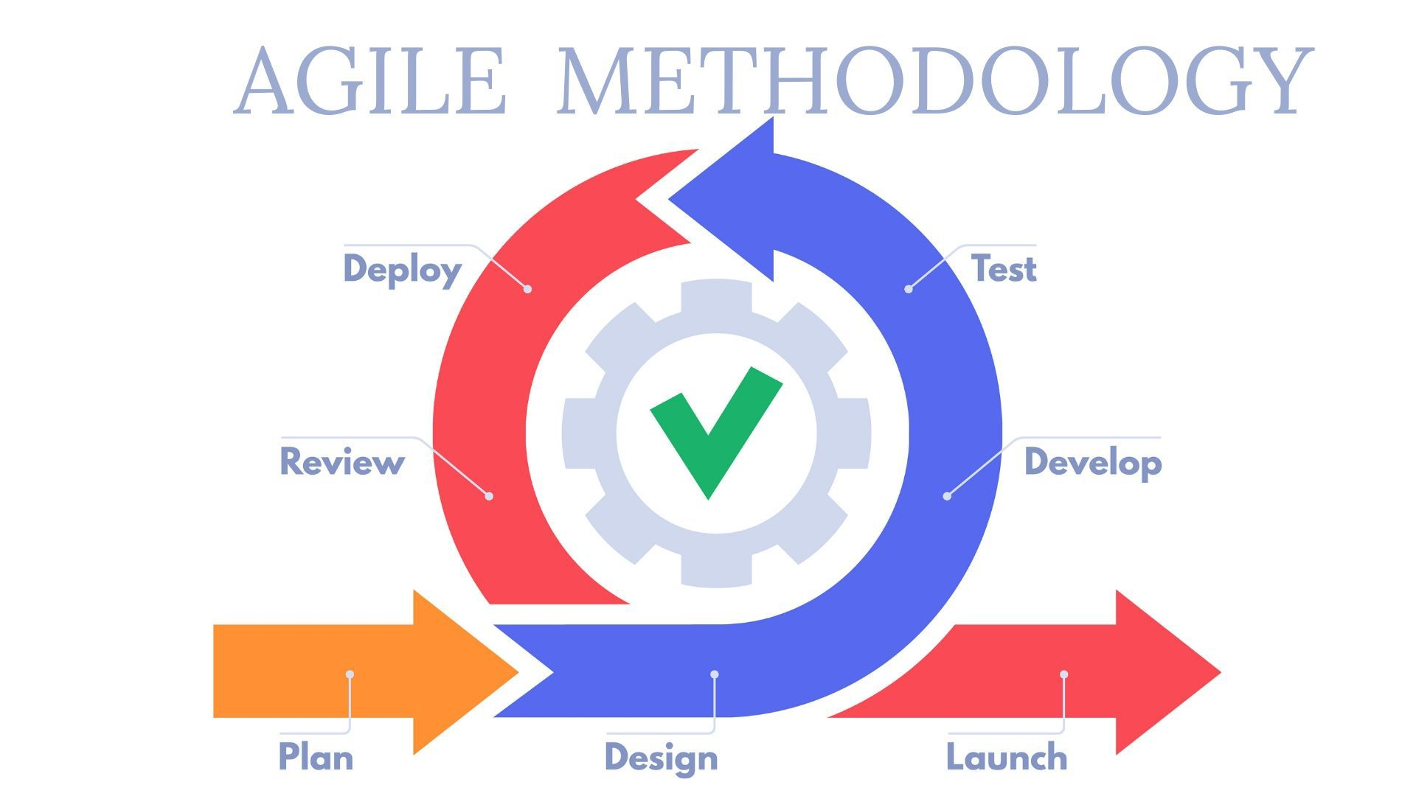
Agile
?
      In software development, Agile practices involve
discovering requirements and developing solutions through
the collaborative effort of self-organizing and cross-functional teams and their customers.]
      It advocates
        adaptive planning,
        evolutionary development,
        early delivery,
        continual improvement and
        flexible responses to change
MVP Phase

Slide 3
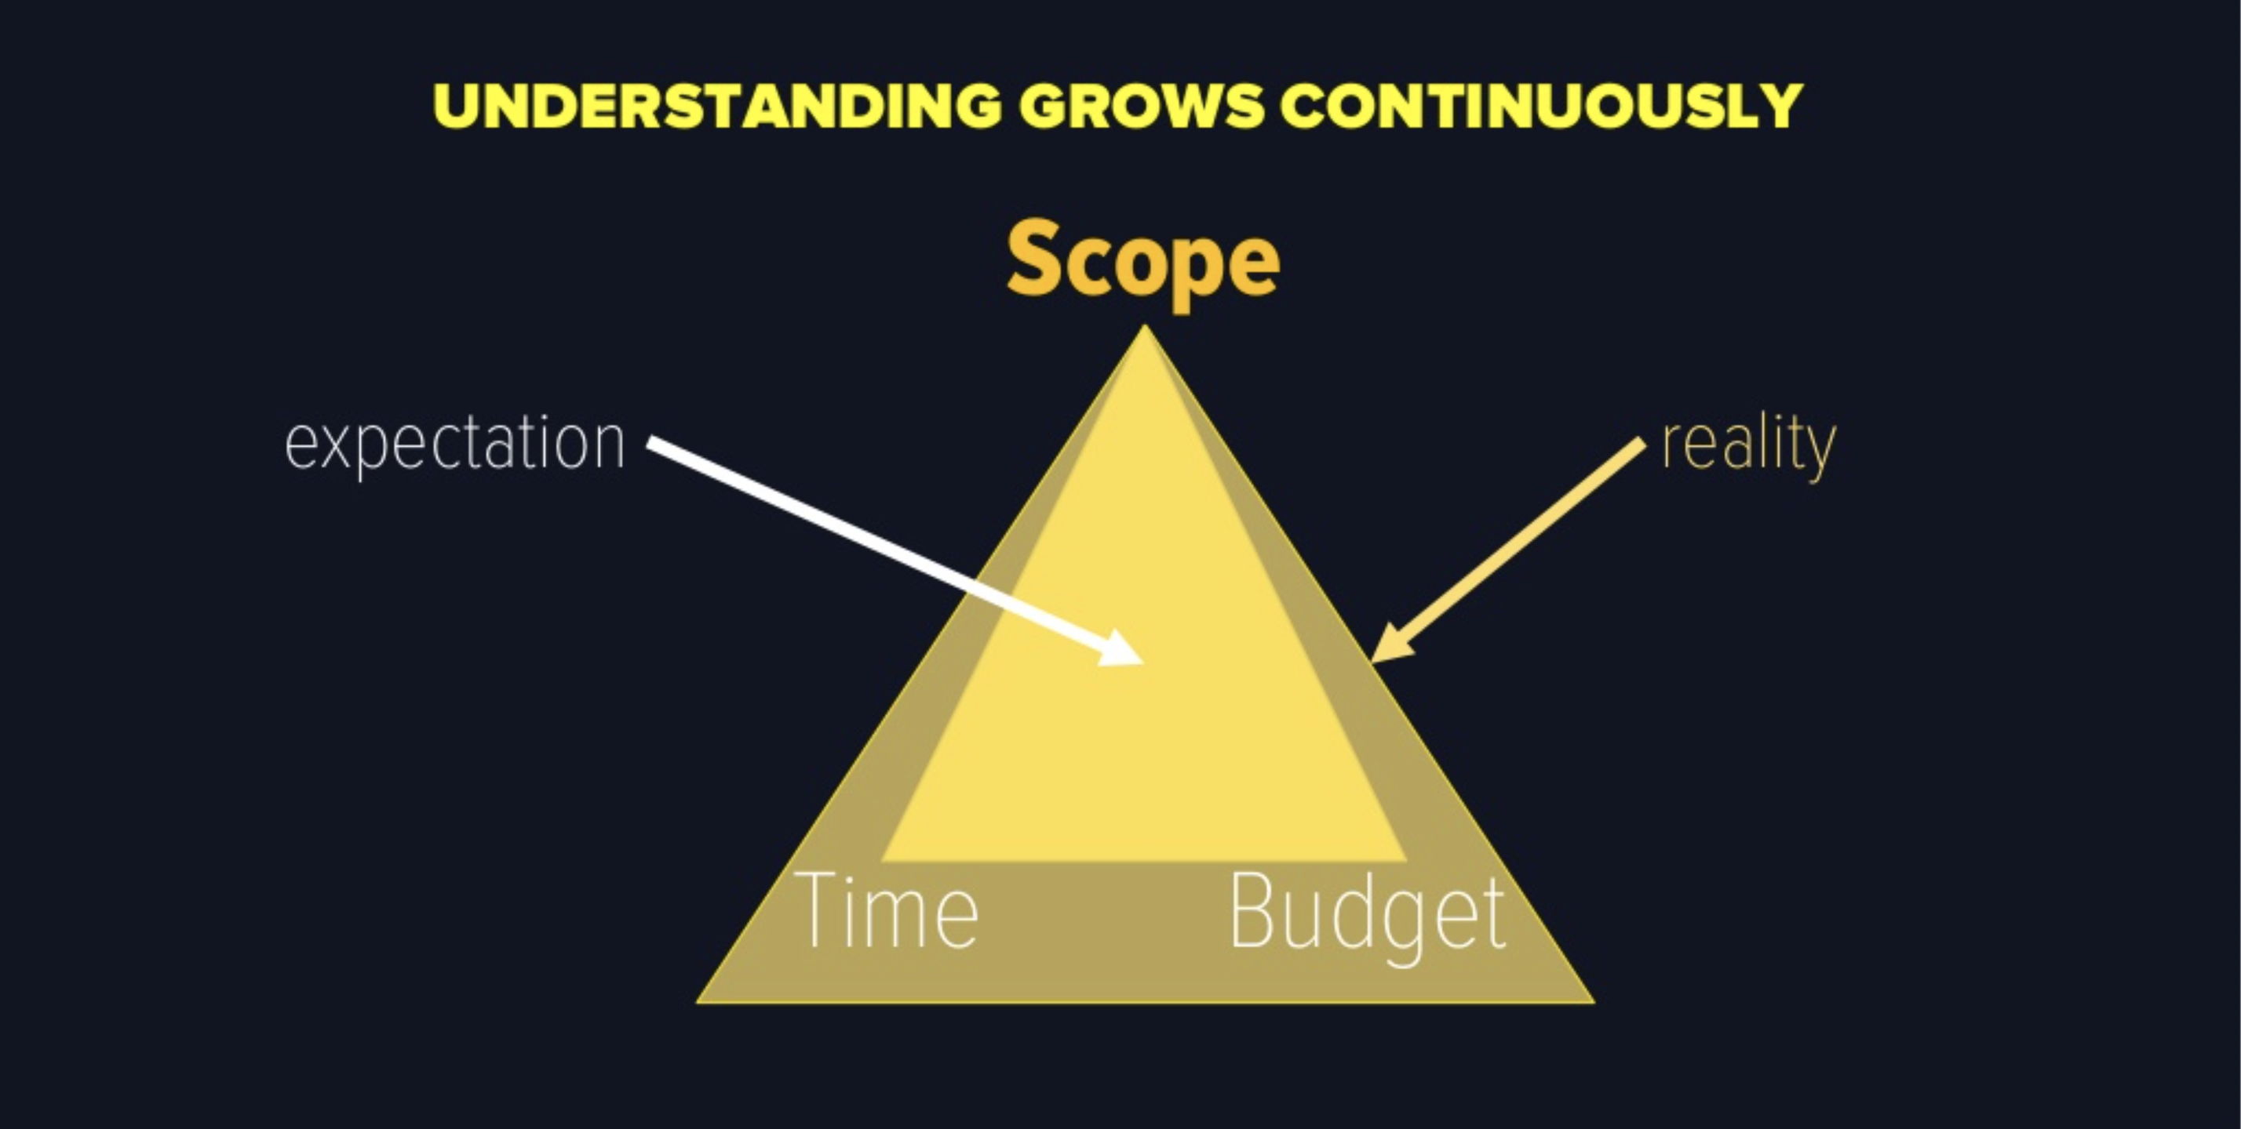
Software Evolution
?
?
MVP Phase
MVP Phase
Phase II & III
and
Support
Phase
Notes:
VMware ESXi (formerly ESX) is an enterprise-class, type-1 hypervisor developed by VMware for deploying and serving virtual computers

Slide 4
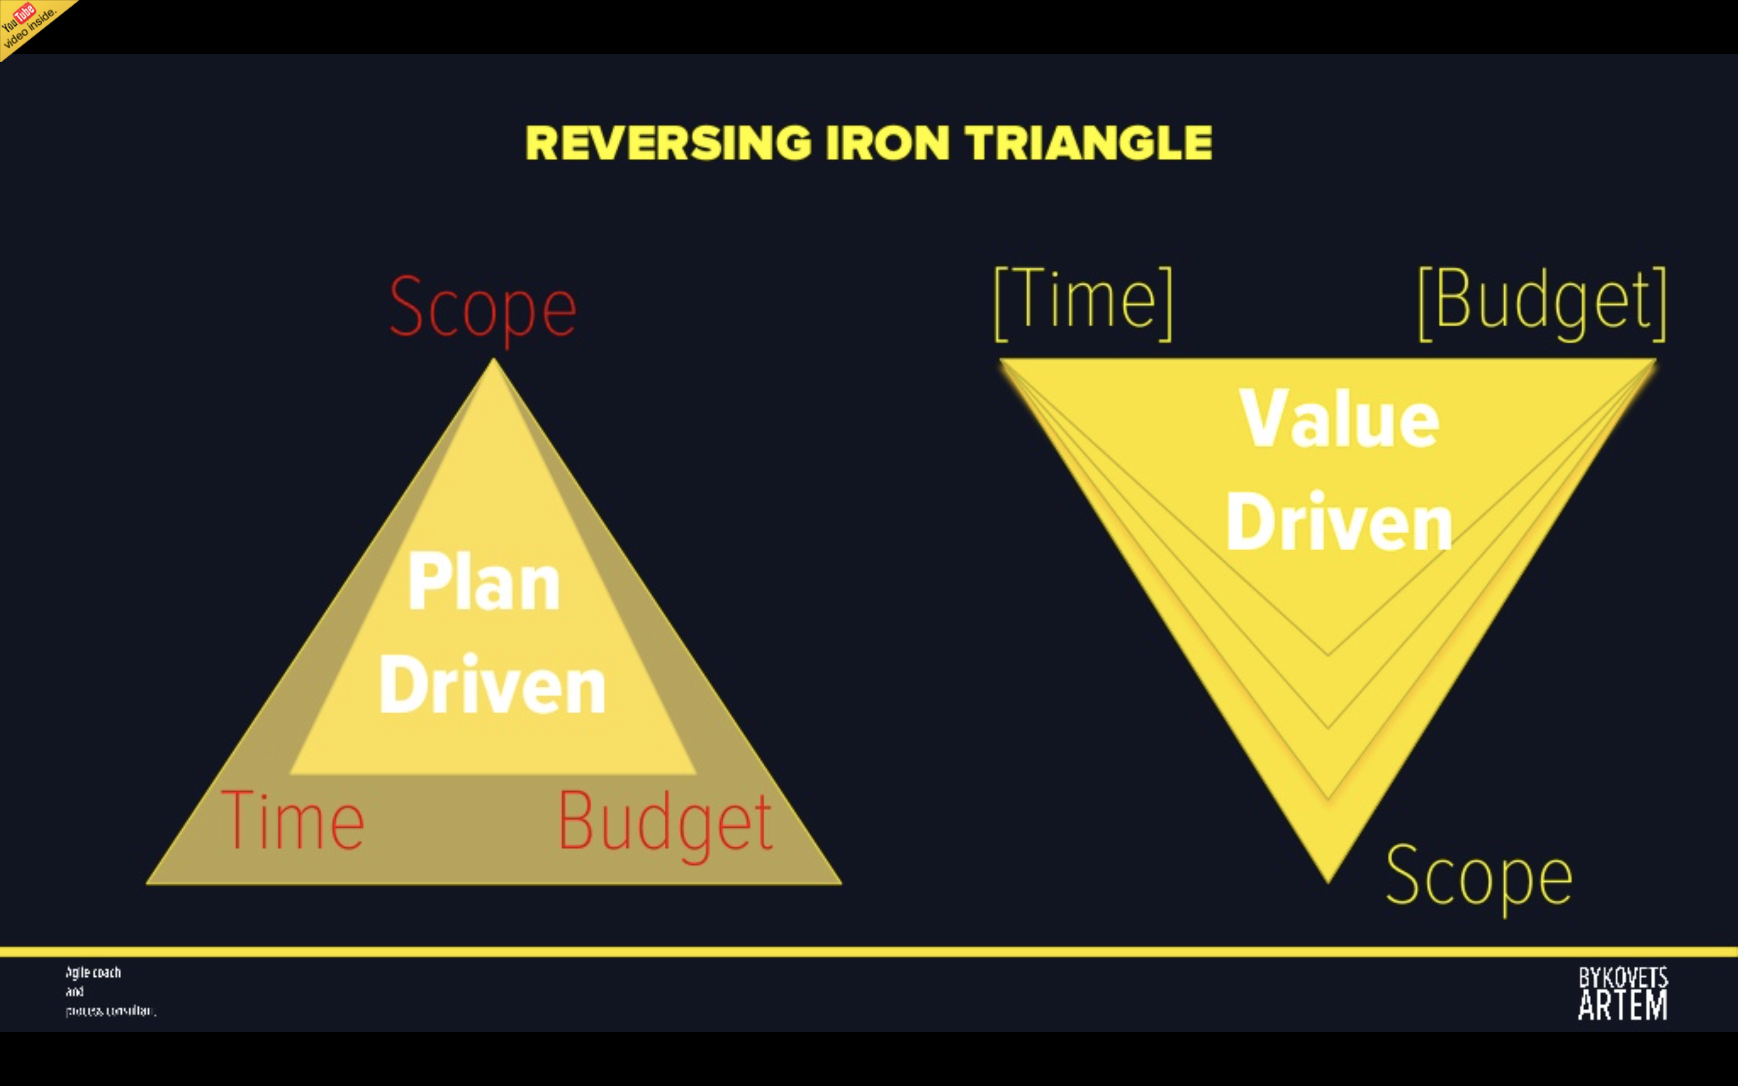
Agile approach
?
MVP Phase
MVP Phase
Phase II & III
and
Support
Phase
Notes:
VMware ESXi (formerly ESX) is an enterprise-class, type-1 hypervisor developed by VMware for deploying and serving virtual computers

Slide 5
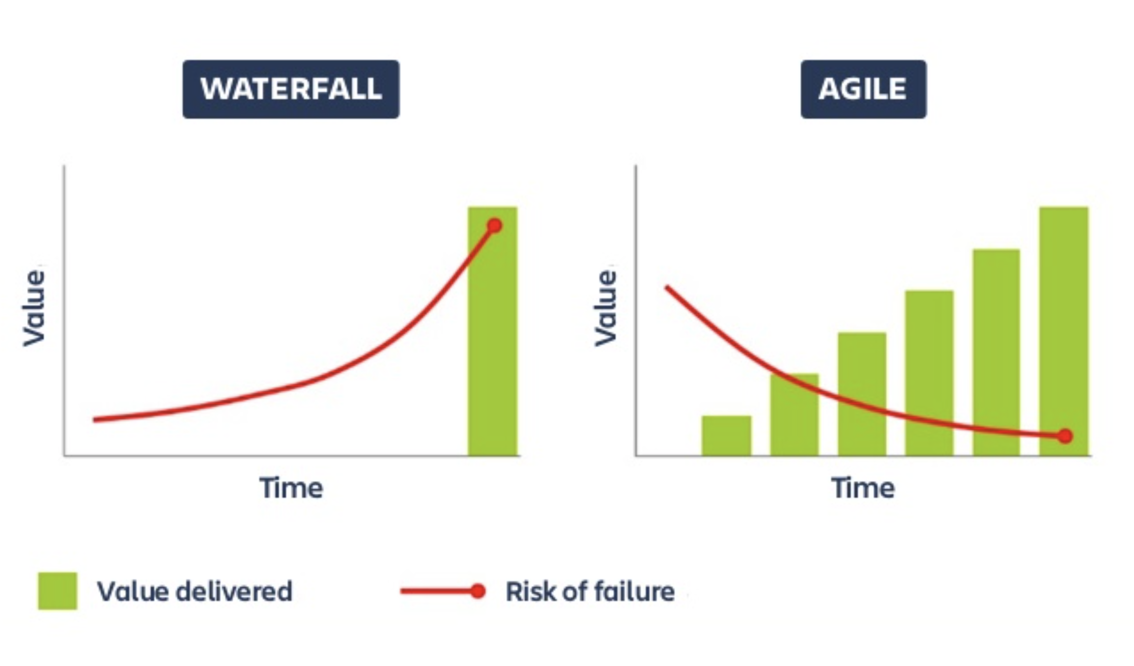
Deliver Value - Incrementally and early
?
MVP Phase
MVP Phase
Phase II & III
and
Support
Phase
Notes:
VMware ESXi (formerly ESX) is an enterprise-class, type-1 hypervisor developed by VMware for deploying and serving virtual computers

Slide 6
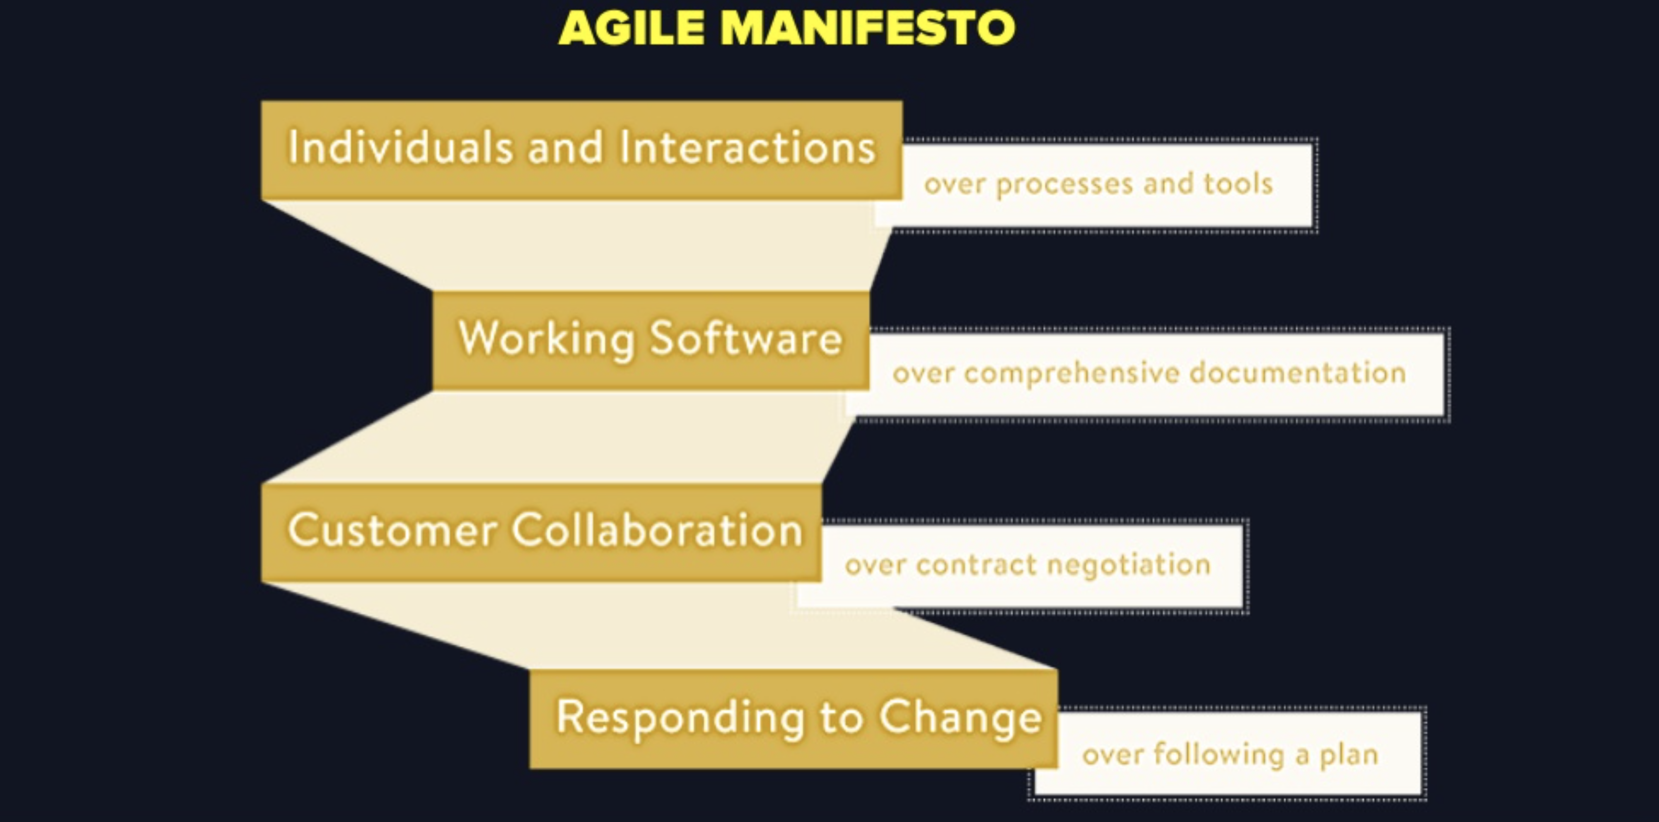
?
MVP Phase

Slide 7
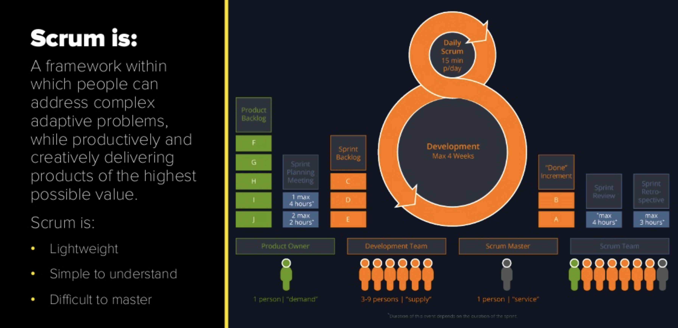
?
MVP Phase

Slide 8
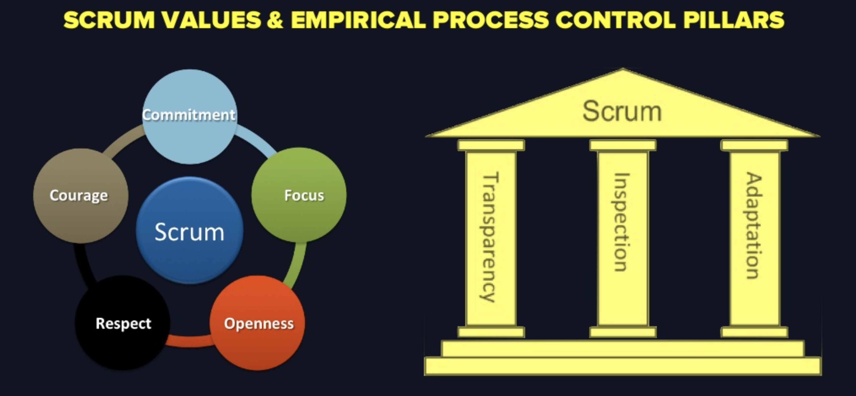
?
MVP Phase

Slide 9
Sprint Events
Event | Inspection | Adaptation
Spring Planning | Product Backlog Commitment Retrospective Definition of Done | Sprint Goal Forecast Sprint Backlog
Daily Scrum | Progress forward on Sprint Goal | Sprint Backlog Daily Plan, Progress, Blockers
Spring Review | Product increment Product Backlog (Release) | Product Backlog
Sprint Retrospective | Team and Collaboration Technology and Engineering Definition of Done | Actionable Improvements
?
MVP Phase

Slide 10
Role of Scrum Master
The Scrum Master is accountable for establishing Scrum by helping everyone understand Scrum theory and practice, both within the Scrum Team and the organization
?
MVP Phase
The Scrum Master is accountable for the Scrum Team’s effectiveness. They do this by enabling the Scrum Team to improve its practices within the Scrum framework
Scrum Masters are true leaders who serve the Scrum Team and the larger organization.

Slide 11
Role of Scrum Master
?
Actively Does Nothing
Asks Questions and Helps Explore
Helps building Shared Understanding
Teaches and Mentors
Protect Teams and challenges environment
MVP Phase

Slide 12
Role of Scrum Development Team
Developers are the people in the Scrum Team that are committed to creating any aspect of a usable Increment each Sprint.
?
The specific skills needed by the Developers are often broad and will vary with the domain of work. However, the Developers are always accountable for:
  Creating a plan for the Sprint, the Sprint Backlog;
  Instilling quality by adhering to a Definition of Done;
  Adapting their plan each day toward the Sprint Goal; and,
  Holding each other accountable as professionals
MVP Phase

Slide 13
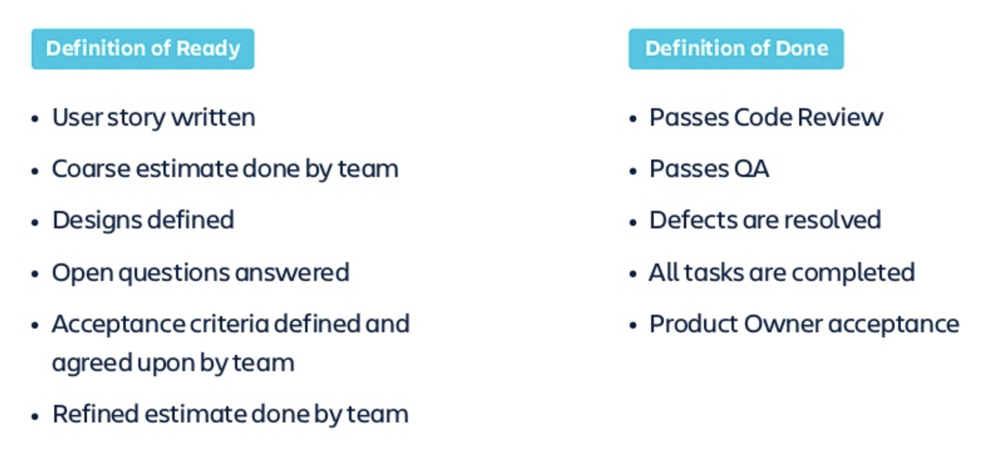
Definitions
?
MVP Phase

Slide 14
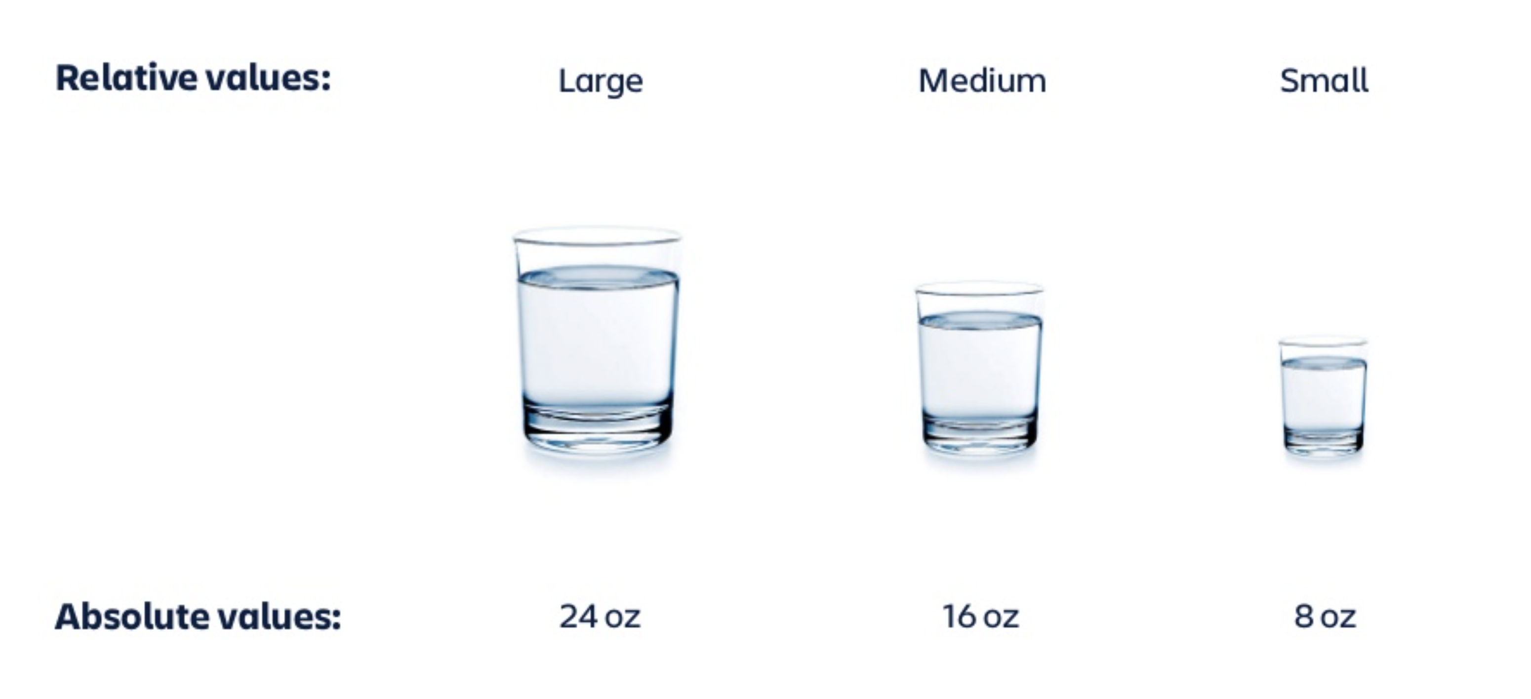
Agile Estimation
?
MVP Phase

Slide 15

Story Pointing & Planning Poker
?

Slide 16

Relative Parameters
?

Slide 17
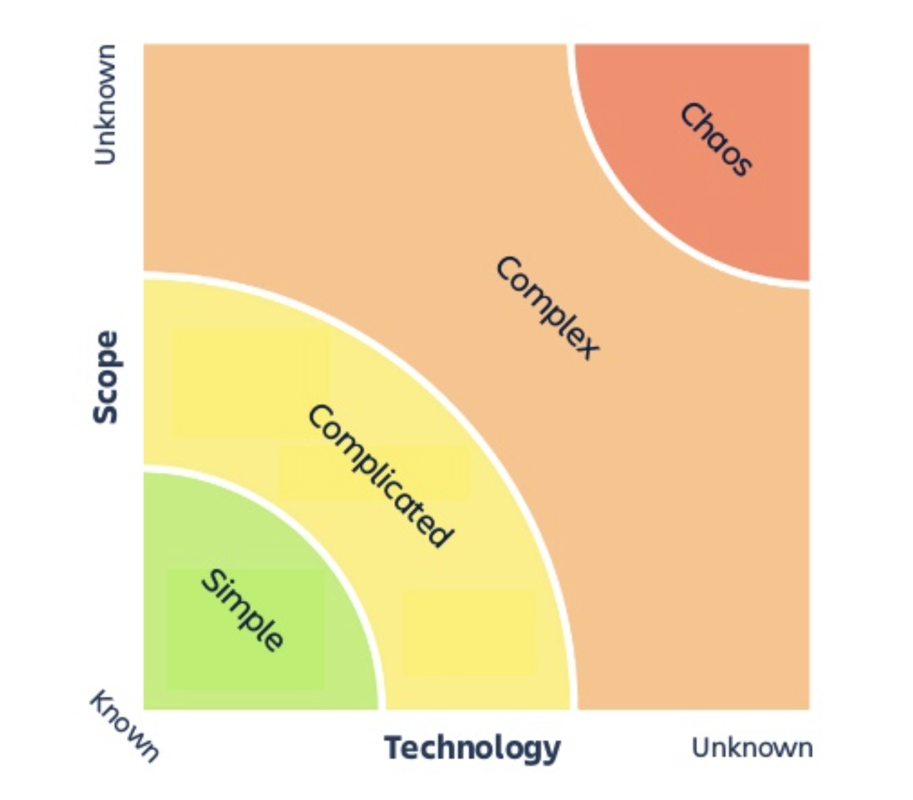
Agile Designed for Complexity and Uncertainty
?

Slide 18
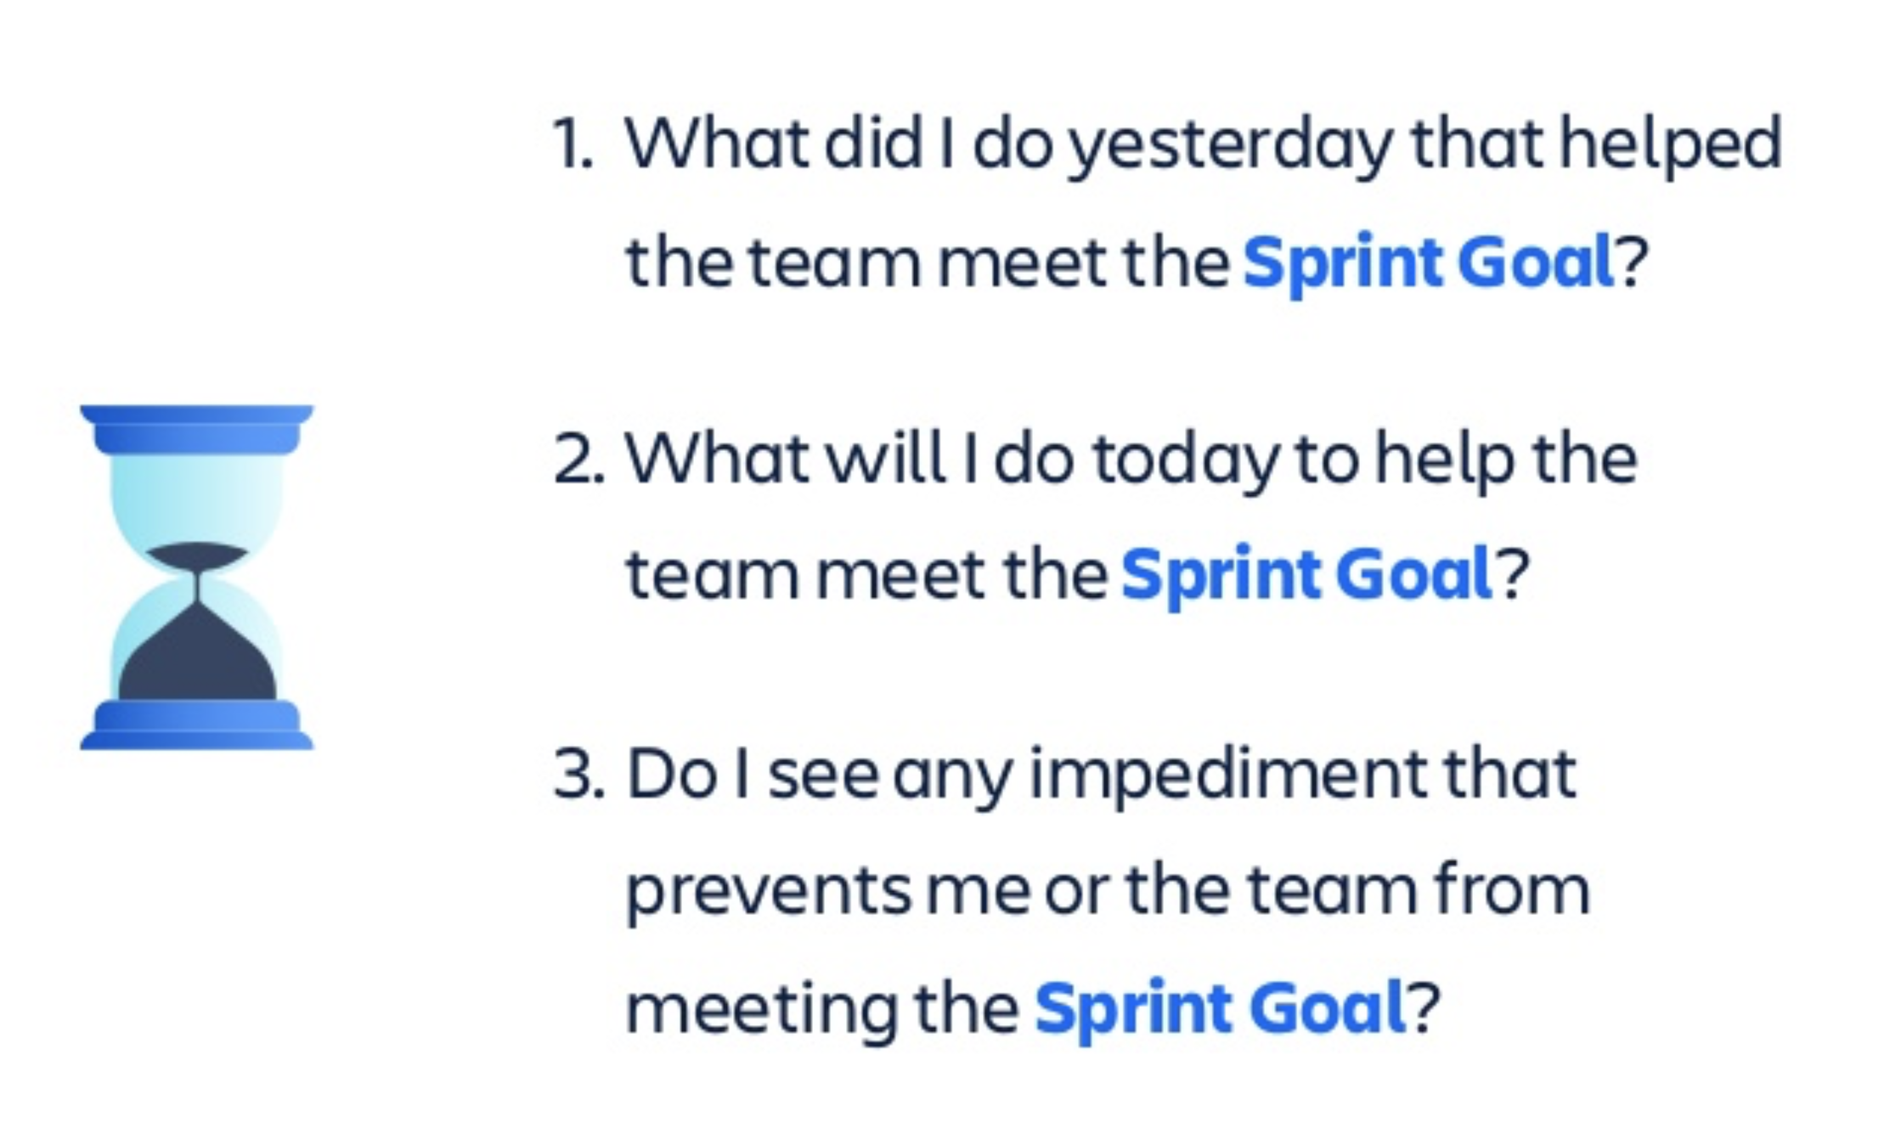
Daily Stand-up
?
MVP Phase

Slide 19
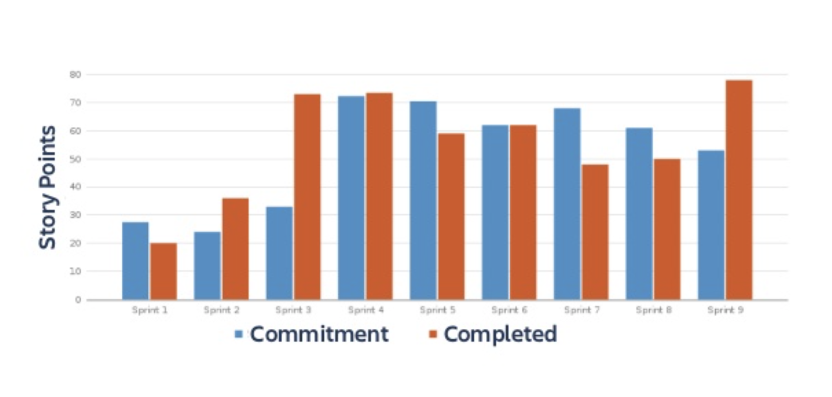
Velocity
?
MVP Phase

Slide 20
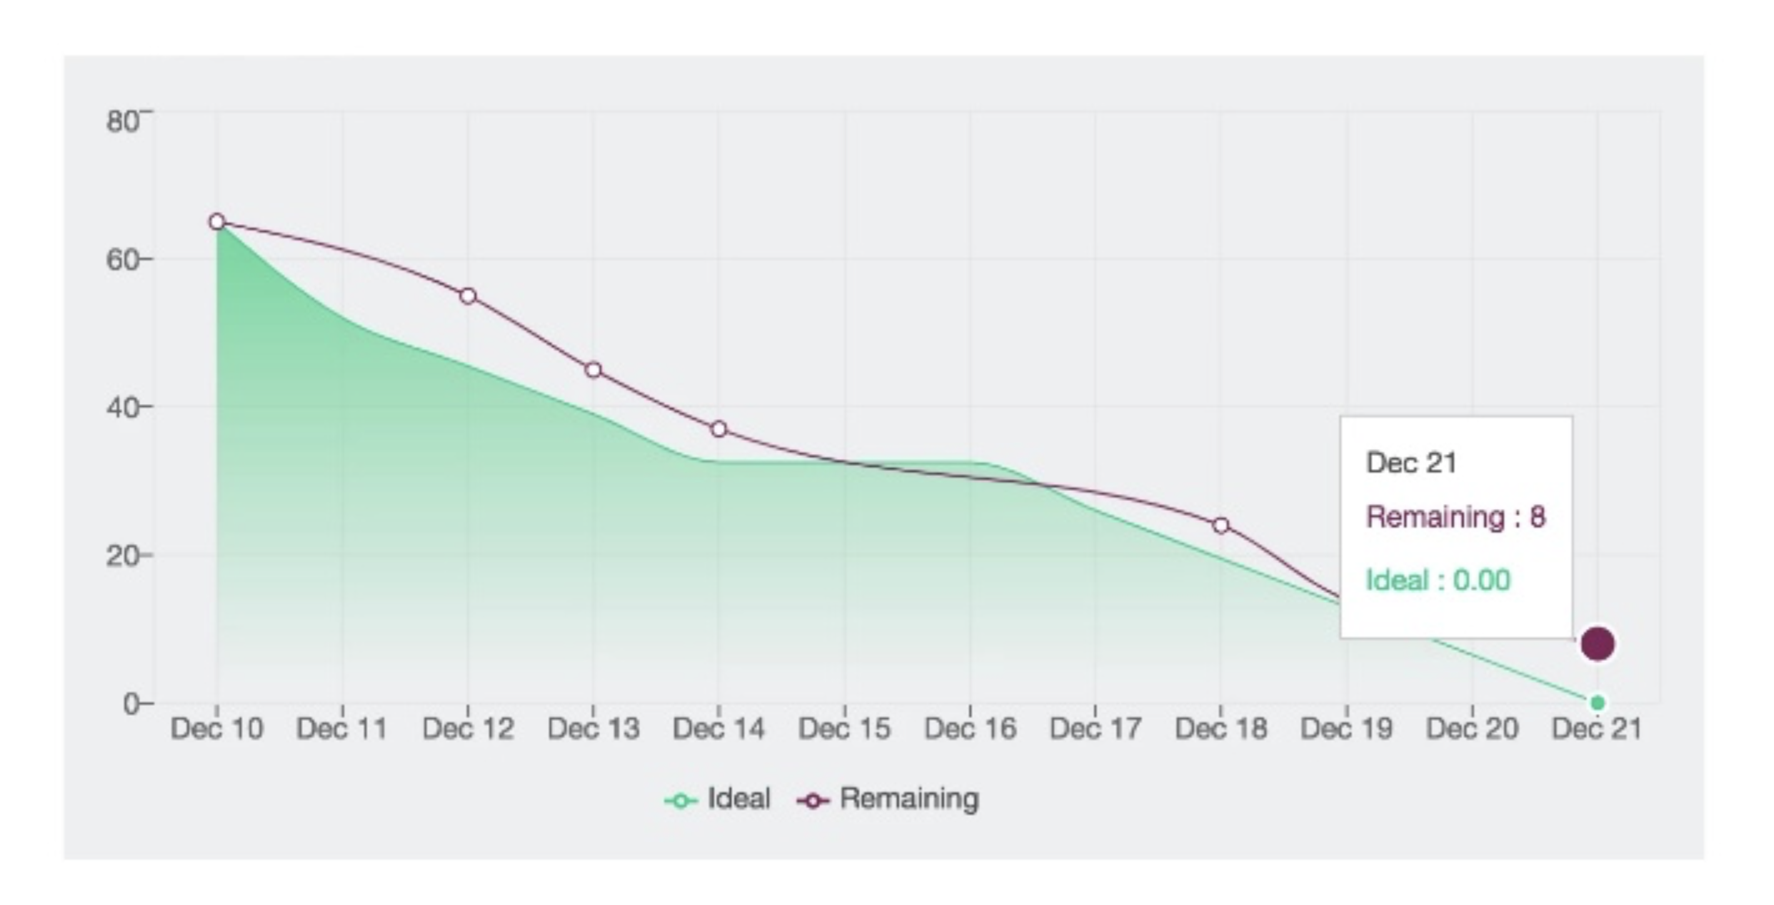
Work Burndown
?
MVP Phase

Slide 21
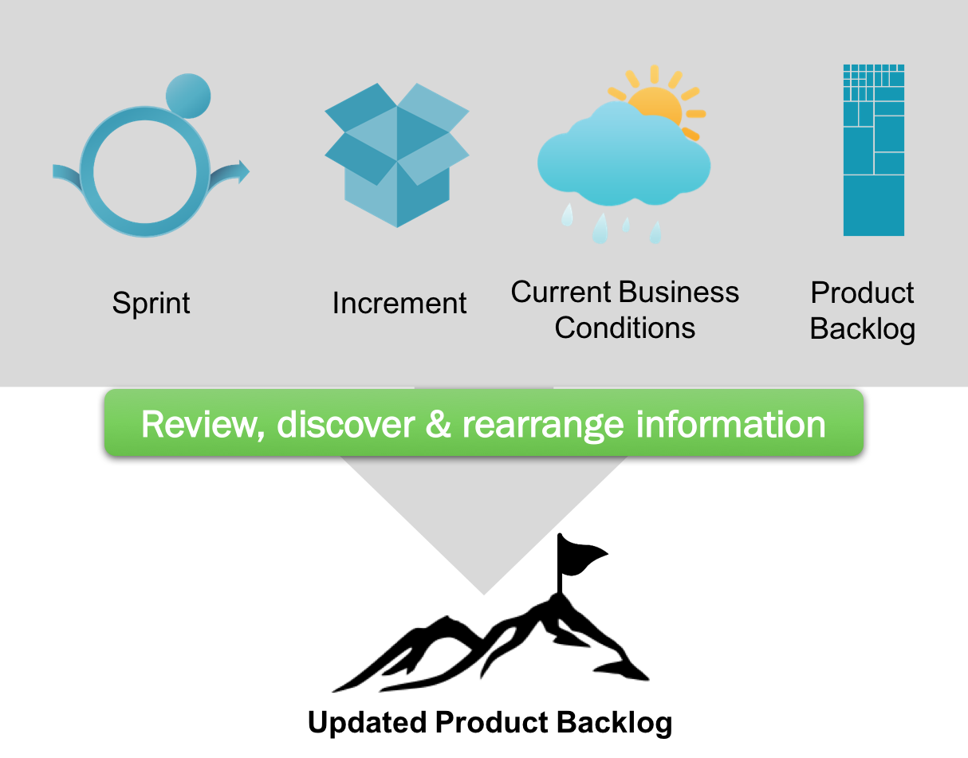
Sprint Review
Inspect the outcome of the Sprint and determine future adaptations.
  Scrum Team, Product Owner and key Stakeholders
  Developers demo the work “Done” and answer questions
  Product Owner reviews what Product Backlog items have been “Done” and what has not been “Done”
  Review of how the marketplace or potential use of the product might have changed what is the most valuable thing to do next
  Provides valuable input to subsequent Sprint Planning
?
MVP Phase

Slide 22
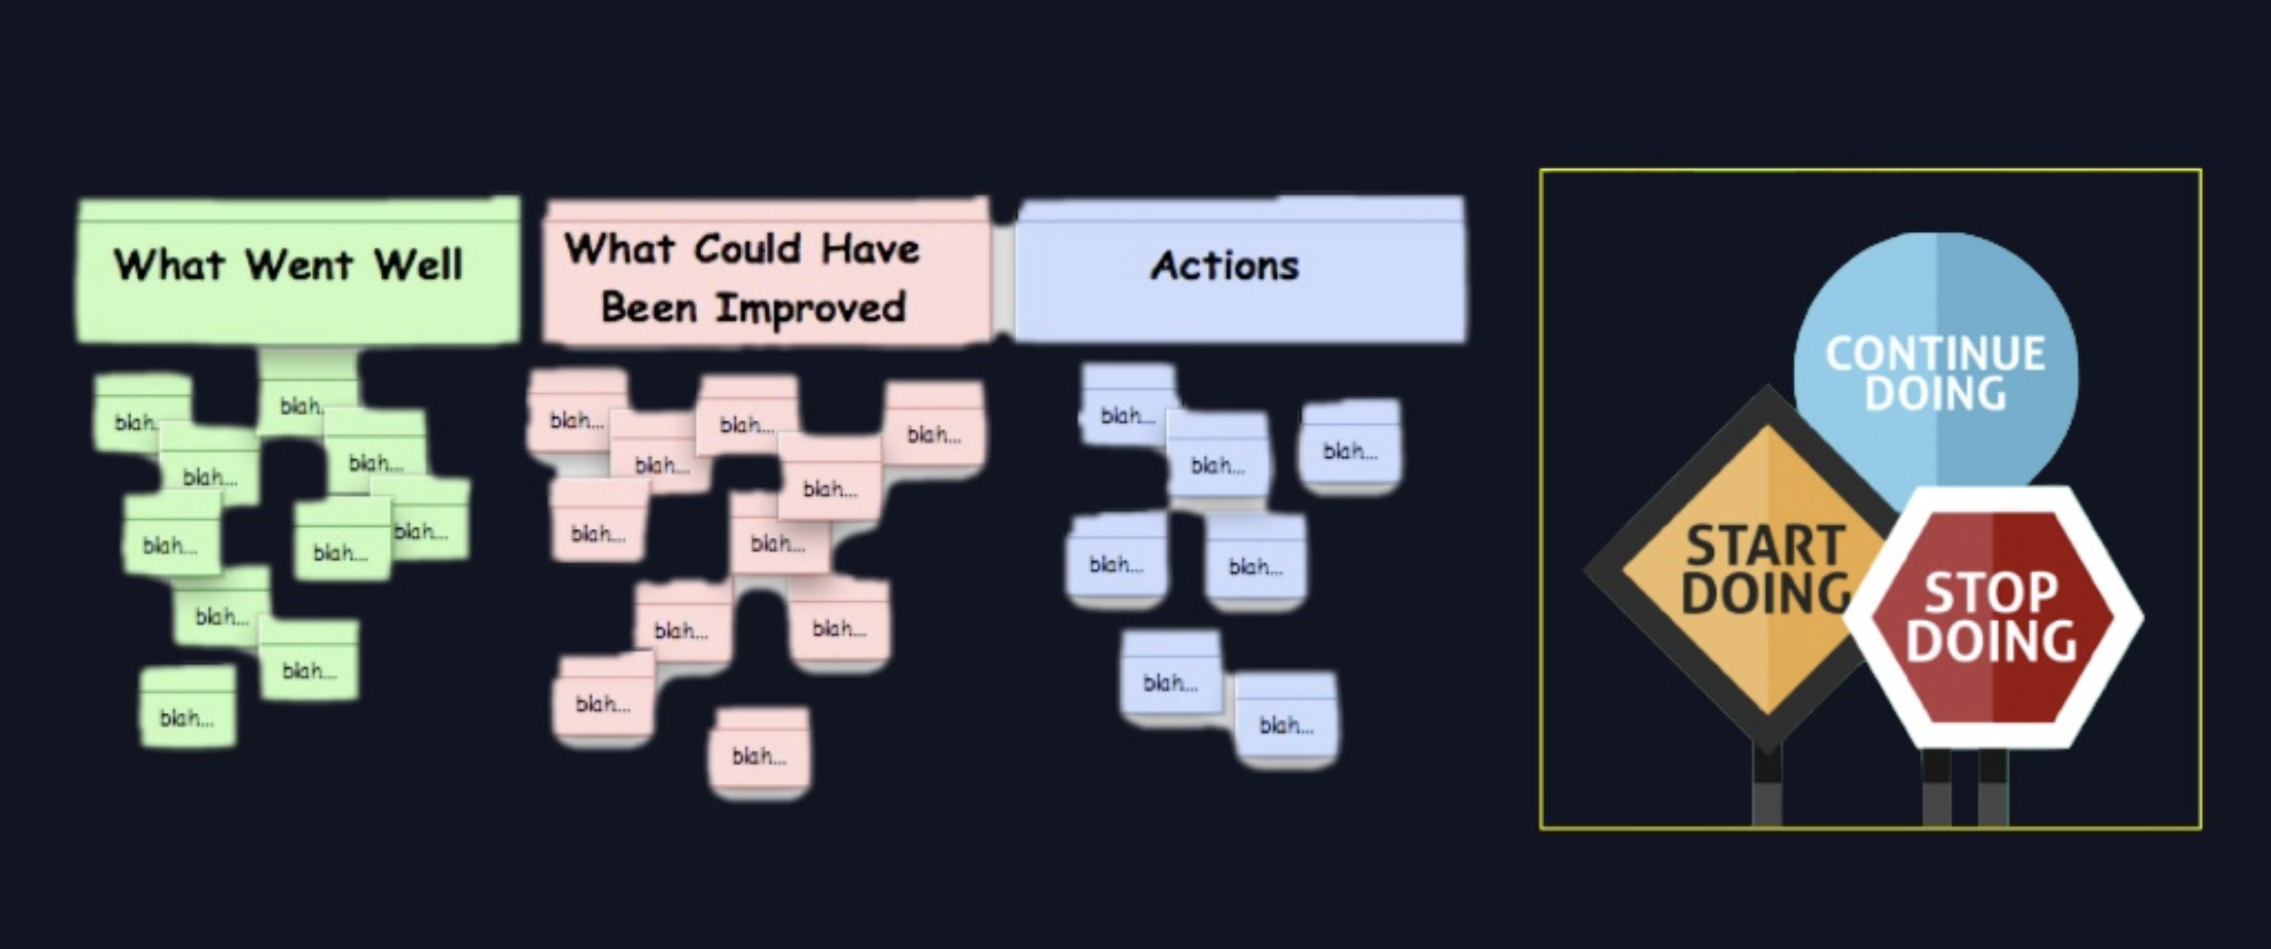
Sprint Retrospective
?
MVP Phase

